Slide 1

Toby’s Terror
Interactive horror video game with an AI foe
Skynet Dev Club:
Hunter King
Dhruv Maniar
Taylor Dobson
Sebastian Baglo
Notes:
Hello and welcome.
We are group Skynet Dev Club, and we are making Toby’s Terror, which is a interactive horror video game with an AI foe.
This is a singular problem that we will be working with over the semester.

Slide 2
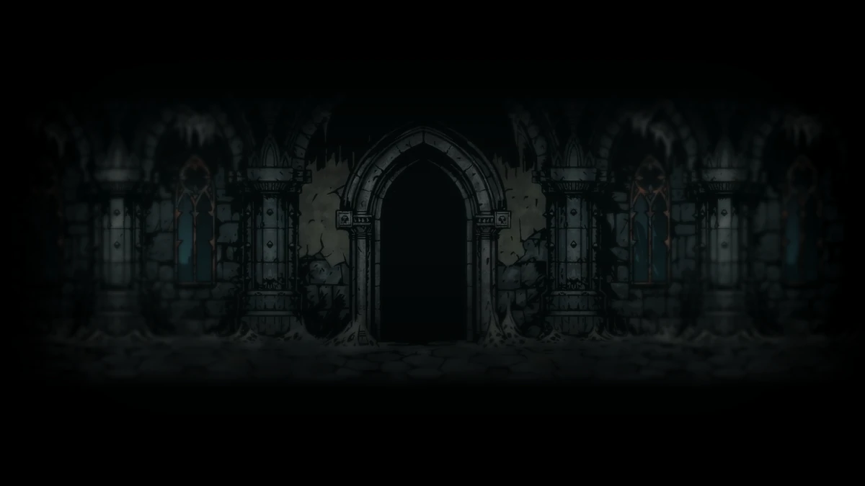
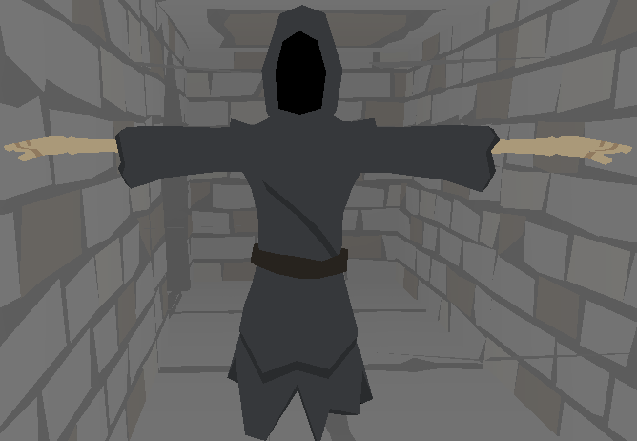
Artificial Intelligence problem
AI which interacts with the environment and the player
The goal is for the AI to navigate and make decisions on its own.
Includes problems like: environment interaction & behaviour and player & AI - interaction.
More dynamic, tweaks to parameters progressing throughout the game.
Lessons learned: Use tools available, clear common idea, get the foundation set, branching
Unity, GitHub, VSCode 👍🏻 GitHub in general 👎🏻
Notes:
We have an AI which interact with its environment and the player and The general AI problem is its behaviour in the environment and the AI tracking a players movement.
The goal is for the AI to navigate and make decision on its own in the environment, capturing the player, doing this in a way that is benefitting the game experience. This includes problems and difficulties like: environment interaction & behaviour, for the AI. and player & AI - interaction. Further problems and difficulties include making the AI more dynamic and non predictable, as well as tweaks to its parameters progressing throughout the game.
When it comes to lessons learned, i will talk mention more the general thing, and we will talk about the AI specific later in the presentation.: Use the tools available when possible and necessary, so you can spend time on the actual AI part. Important to have clear common idea. Important to setup the project early and get the foundation set. Learned that branching is the way to go for different
What went well/or not so well The implementation with Unity and GitHub went well. tasks, before merging together. But GitHub can still be a lot of hazzel, if you have not worked with it earlier. It is a great tool when it works, but if you are having a problem it can be very frustrating and time consuming

Slide 3
Overview of solutions to the problem in existence
Development of a 2D Game using Artificial Intelligence in Unity
This paper was essential in shaping the intelligent behaviour of our NPC (Toby). This paper explains the creation of NPC characteristics using Finite State Machine (FSM). FSM creates a workflow for TOBY by creating multiple states that can execute on unique triggers. TOBY’S actions will be defined as a set of states: {walk, run, search, follow, scare} … etc. The condition for a state change (which is to transition from one action to another) can be triggered by tricks like time elapsed or by another FSM. FSM’s can also be represented graphically using nodes and transitions which helped visualize the flow of TOBY’s actions.
Citation:
R. M. Sindhu, L. S. P. Annabel and G. Monisha, "Development of a 2D Game using Artificial Intelligence in Unity," 2022 6th International Conference on Trends in Electronics and Informatics (ICOEI), 2022, pp. 1031-1037, doi: 10.1109/ICOEI53556.2022.9776750.
Notes:
Development of a 2D Game using Artificial Intelligence in Unity
This paper was essential in shaping the intelligent behaviour of our NPC (Toby), which for our case is in 3D but still applicable.
This paper explains the creation of NPC characteristics using Finite State Machine (FSM) AI in Unity Game Engine.
FSM creates a workflow for TOBY by creating multiple states that can execute on unique triggers.
TOBY’S actions will be defined as a set: {walk, run, search, follow, scare} … etc., where each action performed is defined as states and the condition for a state change (which is to transition from one action to another action) can be triggered by tricks like time elapsed or by another FSM.
FSM’s can also be represented graphically using nodes and transitions which help visualize the flow of TOBY’s actions.

Slide 4
Overview of solutions to the problem in existence
A navigation mesh for dynamic environments
This paper describes how to implement a navigation mesh, which is a unique data structure to represent walkable space in the 3D environment. It helps plan visually convincing paths through the complicated environment. A nav mesh built into the Unity 3D engine was used in our project to be implemented on to a static environment. The environment was then populated with some convex polygonal obstacles. The methods described in the paper made the routine much faster.
Citation:
Toll, Wouter G. van, et al. “A Navigation Mesh for Dynamic Environments.” Computer Animation and Virtual Worlds, vol. 23, no. 6, Wiley, June 2012, pp. 535–46. https://doi.org/10.1002/cav.1468.
Notes:
A navigation mesh for dynamic environments :
This paper describes how to implement a navigation mesh
which represents walkable space in the 3D environment.
It helps plan visually convincing paths through the complicated environment.
A nav mesh built into the Unity 3D was used in our project to be implemented on to a static environment.
The methods described in the paper made the routine much faster.

Slide 5
New ideas
Raycast Correction
Move object next position in an attempt to stop toby from getting stuck in corners.
If toby’s front distance and left or right distance is too close to a rigid body It will add or subtract from position accordingly
Notes:
Toby gets stuck on walls and corners
cast a ray in front, to left and right of toby to receive the distance to nearby rigid body (walls)
nudge next target position based on distance the rays return

Slide 6


System Requirements
Packages through Unity Asset Store:
Modular First Person Controller
POLYGON Dungeons
Notes:
Works on every operating system, (Linux, Mac OS, Windows). We use C# as our programming language with Unity and Visual Studio 2019 as our editors. The reason for using C# is because it has a lot of documentation with regards to AI work and general programming problems. Unity was preferred because it is a well used and solid platform for game development.
Does not require anything crazy when it comes to hardware.
We used different packages and assets for the game environment to make sure the focus of the project was on the AI part, and not everything around it.

Slide 7
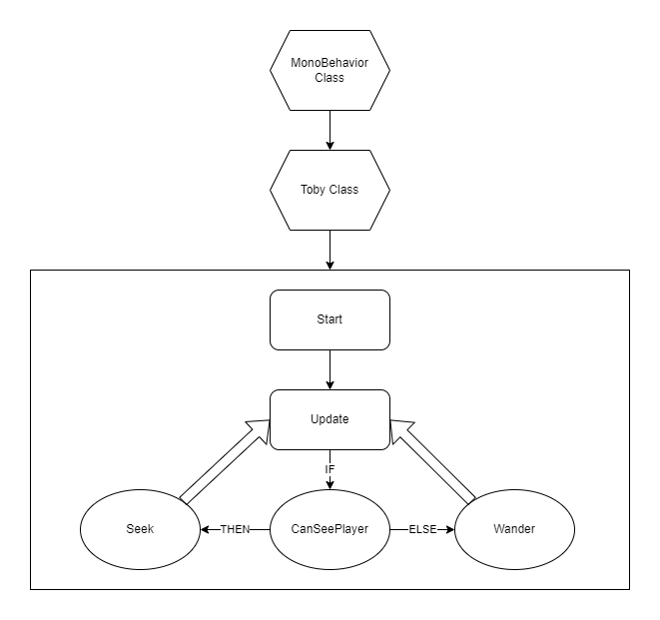
Design:
Architecture
Diagram
Notes:
Regarding our architecture design, MonoBehaviour is the base class from which every Unity script derives.
When using C#, you must explicitly derive from the MonoBehaviour class.
We inherit MonoBehaviour into our custom class named Toby.
Within that class, there are two necessary MonoBehaviour functions to call, Start and Update.
Start is called on the frame when a script is enabled just before the Update method is called the first time.
The Update method is called every frame, which enables the agent to continuously act within the game world based on the functions called within Update.
Those functions are based on seeing the player and thusly pursuing them, or continue wandering.

Slide 8
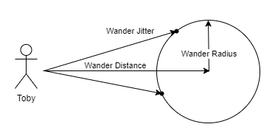
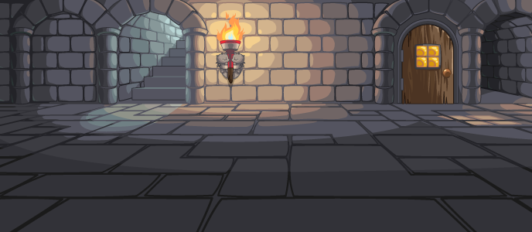
Design: Experiments and Changes
Adjusting the pathing circle.
Tweaking the “seeing” function of the agent.
Notes:
One of the things we had to experiment with was adjusting the wander function to different environments. Upon initial creation and testing, it worked well in open ended environments, but implementation within our current world of narrow hallways and boxy rooms it struggled a bit to not get stuck. This was due to the pathing circle being projected in front of the agent, which could be projected off the map and cause moments of idleness when facing walls.
Explain pathing circle illustration
One change we had to implement was changing how to implement the seeing requirements of the agent. Originally there were two functions that were used for acknowledging the player. One allowed the agent to detect if the player was within a viewing angle of 60 degrees in front of the agent as well as if the agent had any obstructed view to the player. The other dictated the distance between the player and agent where the agent could act upon seeing the player. Upon implementation of these two within the update function, it appeared the agent would ignore the distance function and upon direct sight at any distance would trigger the pursuit. To solve this, the functions were combined into one to simplify the update function calling.

Slide 9
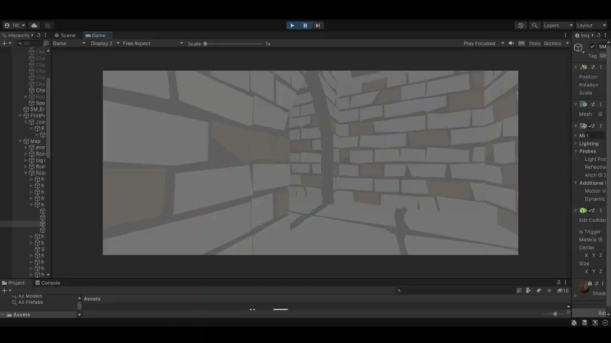
Demo
Notes:
Currently, if you run past him he will switch back to wander.

Slide 10
Work Going Forward
Improved pathfinding
Implement navigation mesh onto a dynamic environment
Multi Finite State Machine
Agent interactions with player
Player interactions with environment
Areas of interest waypoint system

Slide 11
Appendix
Official Documentation:
Taylor Dobson
https://content.ebscohost.com/ContentServer.asp?T=P&P=AN&K=139809142&S=R&D=bth&EbscoContent=dGJyMNXb4kSeprM4zdnyOLCmsEqeqK9Sr664S7CWxWXS&ContentCustomer=dGJyMPGusVCxqrFRuePfgeyx44Dt6fIA
https://ieeexplore-ieee-org.lib-e2.lib.ttu.edu/document/9776750
http://lib-e2.lib.ttu.edu/login?url=https://search.ebscohost.com/login.aspx?direct=true&AuthType=ip,cookie,url,uid&db=aci&AN=157370749&site=ehost-live
Sebastian Baglo
https://ieeexplore-ieee-org.lib-e2.lib.ttu.edu/document/9036471
https://cdn.discordapp.com/attachments/1014883787718545471/1022252485055893564/paper_heuristic_search_algo_shortest_path.pdf
https://jair.org/index.php/jair/article/view/11734

Slide 12
Appendix
Official Documentation:
Hunter King
Smed, Jouni, and Harri Hakonen. “Synthetic Players A Quest for Artificial Intelligence in Computer Games.” Human IT, vol. 7, no. 3, Mar. 2005, pp. 57–77. EBSCOhost, https://search-ebscohost-com.lib-e2.lib.ttu.edu/login.aspx?direct=true&AuthType=ip,cookie,url,uid&db=aci&AN=18021038&site=ehost-live
van Toll, Wouter G., et al. “A Navigation Mesh for Dynamic Environments A Navigation Mesh for Dynamic Environments.” Computer Animation & Virtual Worlds, vol. 23, no. 6, Nov. 2012, pp. 535–46. EBSCOhost, https://doi-org.lib-e2.lib.ttu.edu/10.1002/cav.1468.
Pelechano, Nuria, and Carlos Fuentes. “Hierarchical Path-Finding for Navigation Meshes (HNA⁎).” Computers & Graphics, vol. 59, Oct. 2016, pp. 68–78. EBSCOhost, https://doi-org.lib-e2.lib.ttu.edu/10.1016/j.cag.2016.05.023.
Dhruv Maniar
D. Perez-Liebana, J. Liu, A. Khalifa, R. D. Gaina, J. Togelius and S. M. Lucas, "General Video Game AI: A Multitrack Framework for Evaluating Agents, Games, and Content Generation Algorithms," in IEEE Transactions on Games, vol. 11, no. 3, pp. 195-214, Sept. 2019, doi: 10.1109/TG.2019.2901021.
M. A. Addoum, M. Rouffet and É. Jacopin, "3D Brawler Game Using a Hybrid Planning Approach," 2021 IEEE Conference on Games (CoG), 2021, pp. 1-2, doi: 10.1109/CoG52621.2021.9619075.
C. H. Tan, K. C. Tan and A. Tay, "Dynamic Game Difficulty Scaling Using Adaptive Behavior-Based AI," in IEEE Transactions on Computational Intelligence and AI in Games, vol. 3, no. 4, pp. 289-301, Dec. 2011, doi: 10.1109/TCIAIG.2011.2158434.
R. M. Sindhu, L. S. P. Annabel and G. Monisha, "Development of a 2D Game using Artificial Intelligence in Unity," 2022 6th International Conference on Trends in Electronics and Informatics (ICOEI), 2022, pp. 1031-1037, doi: 10.1109/ICOEI53556.2022.9776750.

Slide 13
Appendix
Unofficial Documentation and Resources:
https://docs.unity3d.com/Manual/index.html
https://assetstore.unity.com/packages/3d/characters/modular-first-person-controller-189884
https://assetstore.unity.com/packages/3d/environments/dungeons/polygon-dungeons-low-poly-3d-art-by-synty-102677

